Slide 1
ESGF Publication, Registration, User Notification Services
Task |  | R&D Area
1.1 |  | Data Management
1.2 |  | User Interface and Search
1.3 |  | Hardware & Network
1.4 |  | Data Transfer
1.5 |  | Installation (Containerized)
1.6 |  | Authentication & Authorization
1.7 |  | Federation
1.8 |  | Quality Control & Assurance
1.9 |  | Replication
1.10 |  | Distributed Search
1.11 |  | Metrics
1.12 |  | User Notification
1.13 |  | Long-tail Publication
1.14 |  | Distributed Computation
1.15 |  | Data Citation
2.1 |  | Provenance Capture
2.2 |  | Workflow
2.3 |  | Dynamic Resources
2.4 |  | In situ Analysis
2.5 |  | Machine Learning
2.6 |  | UQ
2.7 |  | Analytical Modeling
2.8 |  | Mobile Apps
Current capability status:
 | Usable
 | Prototype
 | Research activity
Alexander “Sasha” Ames, Ph.D.
Lawrence Livermore National Laboratory
2017 Triennial Project Review, Potomac, MD
June 8 – 9, 2017
LLNL-PRES-732455
This work was performed under the auspices of the U.S. Department of Energy by Lawrence Livermore National Laboratory under contract DE-AC52-07NA27344. Lawrence Livermore National Security, LLC

Slide 2
Outline
Publication
Adequate metadata (including PIDs and DOIs)
Quality Control (QC): pre-publication, within publication, post-publication
Long-tail publication
Registration (Node Manager)
Tracking and Feedback (User) Notification
Future direction

Slide 3
Publication
Background: Crucial function to populate ESGF data sets in the federation for search and download
Publication uses the “project” concept of organizing data with a common set of requirements, such as controlled vocabulary (CV), file naming, data handling, metadata rules.
Needs: ease of use, flexible configuration, extensible
Current state of practice: direct command-line tool invocation
Supports versioning, PID assignment, CV / metadata checks (not full QA/QC)
Service-based approaches to publishing are in prototype
Goal: full transition to flexible-API services, modular well-designed codebase
Transition from prototype: implementation work
Documentation and outreach needed
Notes:
Data doesn’t come out of thin air. We call it publishing

Slide 4
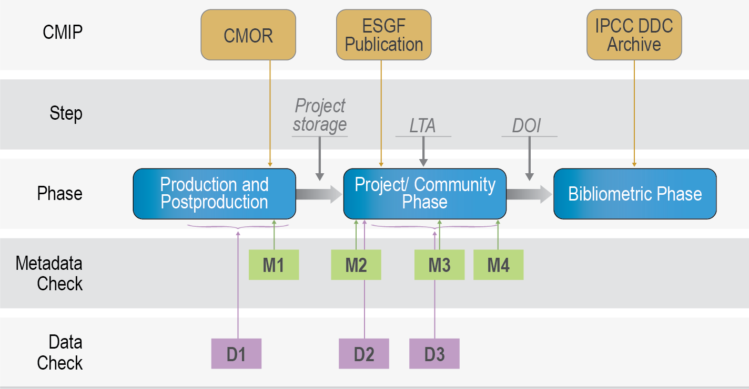
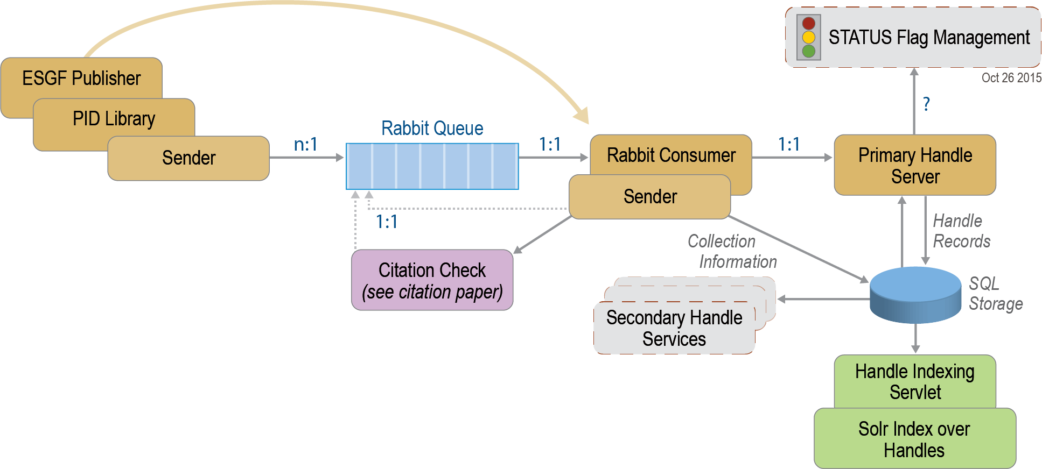
PIDs / QA services
Persistent Identifiers (PIDs) key for data identification and citation
Current state: enabled for CMIP6 – use of message queuing (RabbitMQ) to ensure uniqueness (DKRZ)
Service connects PID to DOI issued for each model
Goal: generalize PID assignment feature and make available to all ESGF projects
Feed PID information created at publishing time into future provenance capture service
Quality Assurance/Control (QA/QC) workflows have been developed and tested for CMIP6 (DKRZ); errata service for post-production (IPSL)
PrePARE (PCMDI) data check tool integrated into the publisher for CMIP6 only
Goal: Generalize QA/QC services integrated into the publication process to benefit additional data projects
Notes:
Persistent Identifiers (PIDs) key for data identification and citation
Current state: enabled for CMIP6 – use of message queuing to ensure uniqueness (DKRZ)
Service connects PID to DOI issued for each model
Goal: generalize PID assignment feature and make available to all ESGF projects
Feed PID information created at publishing time into future provenance capture service
Quality Assurance/Control (QA/QC) workflows have been developed and tested for CMIP6 (DKRZ); errata service for post-production (IPSL)
PrePARE (PCMDI) data check tool integrated into the publisher for CMIP6 only
Generalize QA/QC services integrated into the publication process to benefit additional data projects

Slide 5
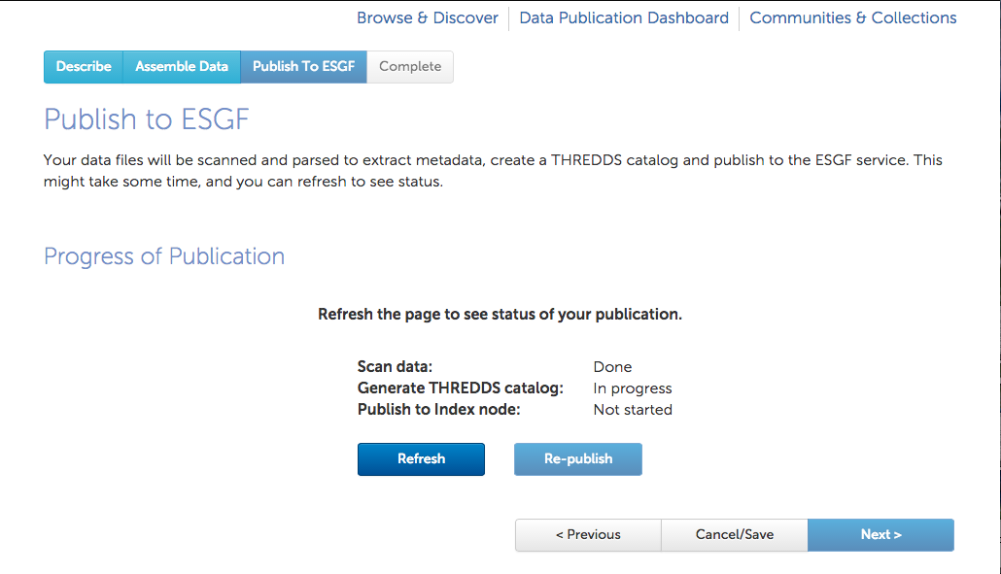
Long-tail publication
Goal: one-off model runs / observational dataset need a convenient means to publish to ESGF
Small data
Heterogeneous
Current state: GUI-based has been in used infrequently for ACME
API has been developed (ANL) but untested
Different requirements but same publisher as the bulk-data publication
Need: iterative development to acquire additional ESGF projects and users
Get feedback from users to drive next round of changes
Notes:
(For our purposes, we consider the issue of sharing of the richly diverse and heterogeneous small data sets produced by individual scientists, so-called long-tail data.)

Slide 6
Registration / Node Manager
Objective: maintain a registry of services, distribute federation wide configuration, monitor node states.
Need: stable platform for high-concurrency and reliability of updates
Benefit: nodes stay up to date; we obtain a complete picture of federation-wide services
Current state: in deployment after a redesign from original prototype (affected by personnel changes)
Supports xml-based registry
Map of node status
Secure credential sharing
Proposed approach: make use of a third-party implementation of a well known protocol (my first choice is RAFT).
Other updates:
Secure protocol for credential sharing extended to metadata updates and node state propagation – this prevents unauthorized server access and information spreading
Support API services to other ESGF modules (need to gather requirements from working team leads)

Slide 7

User notification
(4) Notification (email)
Feedback
Service
Need: Use of outdated data can impact research, risks to scientific integrity. Desired services to alert users to data changes.
Tracking services – match recently updated datasets with some criteria for a user notification.
Use download records to match-up with updates.
Feedback services – batch up notification on a per-user basis and dispatch via email.
Current state: tracking and feedback services prototype development
Expected launch this year
Data Node (Tracking
Service)
(1) User Download
Update Info (3)
(2) Dataset Updates
Challenges: implement tracking over replicas
Better coordination of which projects/sub-project dataset collections are replicated at various sites
Use third-party identity servers – need to query service for user email
Proposed tracking features: (1) enabled saved searches
Eg. I expect the CESM to publish piControl soon, email me when ready
(2) Combine with Machine Learning research to predict if additional datasets are desirable (based on user-download patterns))
Future direction: smartphone notifications via ESGF app (if desired need resources to learn APIs)
Notes:
No scientist wants to have to retract a paper due to the data

Slide 8
Summary
Publishing is essential; great opportunity to improve existing tools with comprehensive services
Improve node manager with third-party consistency protocol
User notification services stand to help reduce error from outdated data

